Slide 1

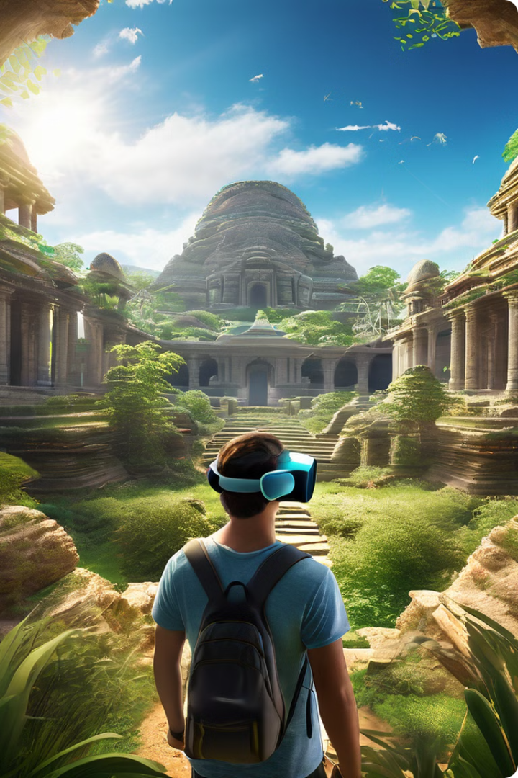

Preserving Cultural Heritage with VR and Digital Archiving
Welcome to our presentation on the transformative power of VR and digital archiving in preserving cultural heritage. We'll explore how these innovative technologies create immersive experiences, foster understanding, and ensure the legacy of our shared history for future generations.
by Kollipara Jaswanth

Slide 2

The Importance of Cultural Heritage Preservation
1
Preserving the Past for the Future
2
Overcoming Physical Limitations
Cultural heritage, encompassing artifacts, traditions, and knowledge, provides invaluable insights into the past and shapes our present. By preserving this heritage, we ensure that future generations can access, learn from, and appreciate the rich tapestry of human history.
Physical preservation of cultural artifacts faces challenges such as decay, damage, and limited accessibility. VR and digital archiving offer solutions to these limitations, allowing for secure preservation and broader access to cultural treasures.
3
Embracing Diversity and Inclusivity
4
Economic and Social Benefits
Preserving cultural heritage promotes understanding and appreciation of diverse cultures. Through these technologies, we can bridge geographical boundaries, fostering a more inclusive and connected world.
Preserving cultural heritage contributes to economic development through tourism and cultural industries. It also strengthens communities by preserving their unique identities and traditions.

Slide 3
Virtual Reality (VR) in Cultural Heritage
Immersive Experiences
Enhanced Learning
Global Accessibility
VR allows us to step into the past, exploring historical sites and artifacts in a way that was never before possible. Through immersive environments, we can experience the grandeur of ancient cities, walk through the halls of historic museums, and examine delicate artifacts up close.
VR goes beyond passive observation, providing interactive elements that engage users in the learning process. Users can manipulate objects, explore different perspectives, and participate in simulated historical events, making learning more engaging and memorable.
VR removes geographical barriers, making cultural heritage accessible to a global audience. Museums and cultural institutions can create virtual exhibits that can be experienced by anyone with a VR headset, regardless of location.

Slide 4
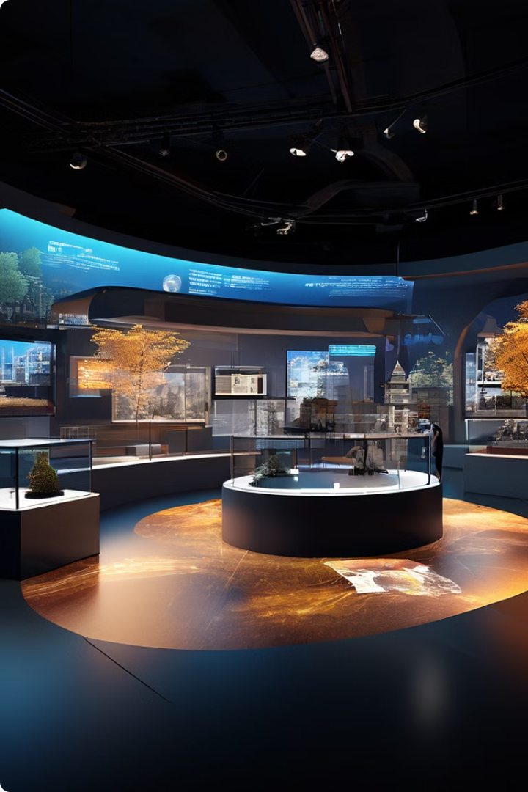
VR Development Tools
Unity
Unity is a popular game engine widely used in VR development due to its user-friendly interface, extensive asset library, and strong community support. It's ideal for creating interactive museum tours, historical event reconstructions, and engaging educational experiences.
Unreal Engine
Unreal Engine stands out for its high-fidelity graphics, robust realistic simulation tools, and powerful scripting capabilities. It's well-suited for creating detailed architectural visualizations, lifelike historical reenactments, and visually stunning immersive experiences.
A-Frame
A-Frame is a web framework for building VR experiences using HTML. It provides a simpler entry point for developers with web development experience, making it accessible for creating basic VR experiences.
Other Tools
Other VR development tools include Oculus Medium, Tilt Brush, and Google Blocks. These tools offer different approaches to 3D modeling, design, and prototyping, providing flexibility for various VR projects.

Slide 5

Digital Preservation Strategies
1
Digitization
Digitization involves capturing physical artifacts in digital formats. This includes scanning documents, creating 3D models, and taking high-resolution photographs. It ensures the preservation of original artifacts while making them accessible to a wider audience.
2
Data Storage
Data storage plays a crucial role in preserving digitized content. Cloud storage solutions offer scalable and secure storage options. Implementing redundancy through multiple backups ensures that data is protected against loss or corruption.
3
Metadata
Metadata provides essential information about digital items, such as the date of creation, author, and context. Using standardized metadata formats ensures searchability and accessibility of digital collections. Metadata is essential for finding and understanding the value of digital items.

Slide 6
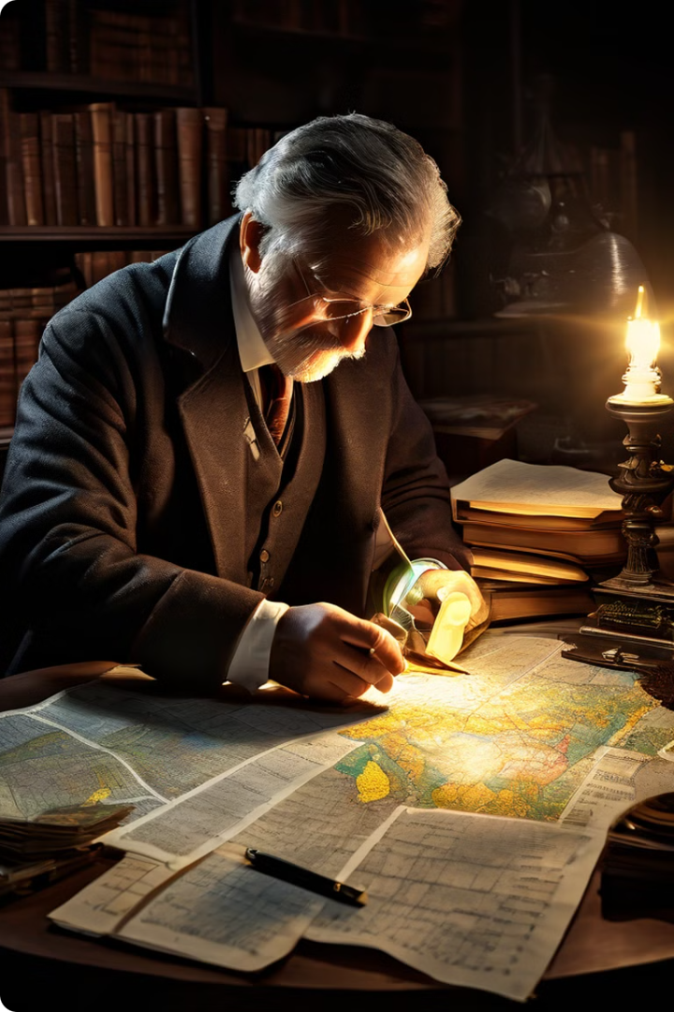
Methodologies for Historical Research
Sources
Techniques
Archival Documents
Text analysis, network analysis, visualization
Oral Histories
GIS mapping, text mining, data analysis
Archaeological Data
3D modeling, virtual reconstruction, simulation
Digital Resources
Data visualization, data storytelling, digital humanities approaches

Slide 7
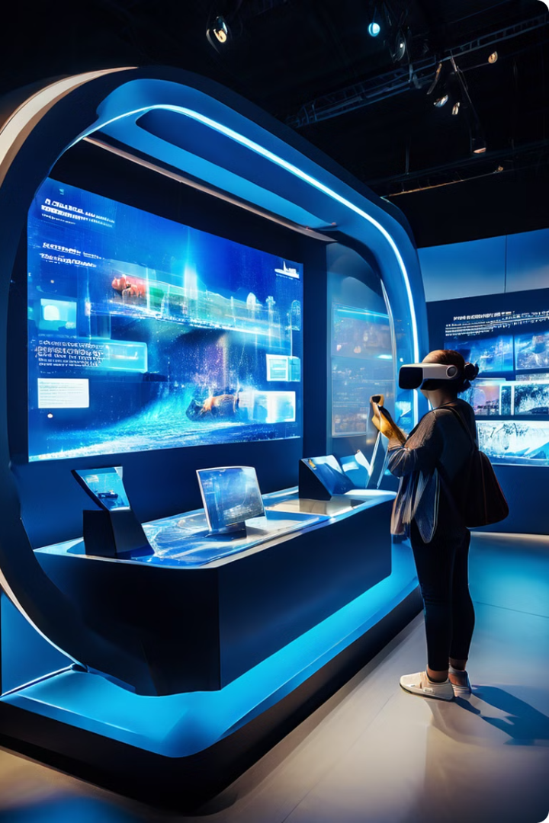



Digital Curation and Exhibits
Selection
Curators meticulously select significant items for digitization, ensuring the preservation of the most valuable and representative artifacts.
Organization
Digital content is organized and structured for accessibility and ease of navigation. This involves creating hierarchies, using tags and keywords, and designing intuitive interfaces.
Presentation
Digital platforms are used to display curated content in engaging and interactive ways, allowing users to explore artifacts, learn about history, and connect with cultural heritage in new and innovative ways.

Slide 8
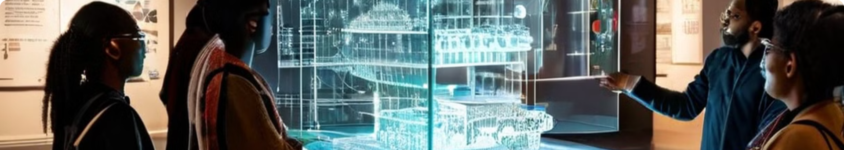




Ethical Considerations in Digital Preservation
Cultural Sensitivity
Intellectual Property
Sustainability
Digital representations must be culturally sensitive and respectful of the values and significance of the heritage being preserved. Consultation with cultural groups is crucial to ensure appropriate representation and avoid misinterpretations.
Respecting copyright and ownership of digital content is paramount. Permissions must be secured for use and distribution of digitized items, ensuring ethical and legal compliance.
Ensuring long-term access to digital archives requires careful planning and maintenance. Regular updates, preservation of digital files, and the development of sustainable strategies are crucial for maintaining the accessibility of digital heritage.

Slide 9

Challenges and Future Directions
1
Technological Limitations
Challenges include the high costs associated with VR development, the need for specialized skills and equipment, and the ongoing development of more advanced VR technologies.
2
Funding
Securing financial resources for long-term digital preservation projects is crucial. Engaging with donors, government agencies, and private organizations is essential to sustain these initiatives.
3
Training
The need for skilled professionals in digital archiving, VR development, and cultural heritage management is growing. Investing in training and education programs is crucial to develop the workforce necessary for successful digital preservation.
4
Accessibility and Inclusivity
Ensuring that digital heritage projects are accessible to all individuals, regardless of location, disability, or socioeconomic background, is a key challenge and an ongoing priority.

Slide 10
Contact, Discussion, and Thank You
Contact Us: Jaswanth Kollipara
Thank you all for your time and attention. We hope this presentation has provided valuable insights into the capabilities and future of Personal Finance Manager.
or email us at info@kjaswanth28@gmail.com Please feel free to raise your hand or use the discussion chat to participate in the Q&A session.
We welcome your questions and feedback.

